Slide 1
Module 6 - SQL Data Manipulation Language (DML)

Slide 2
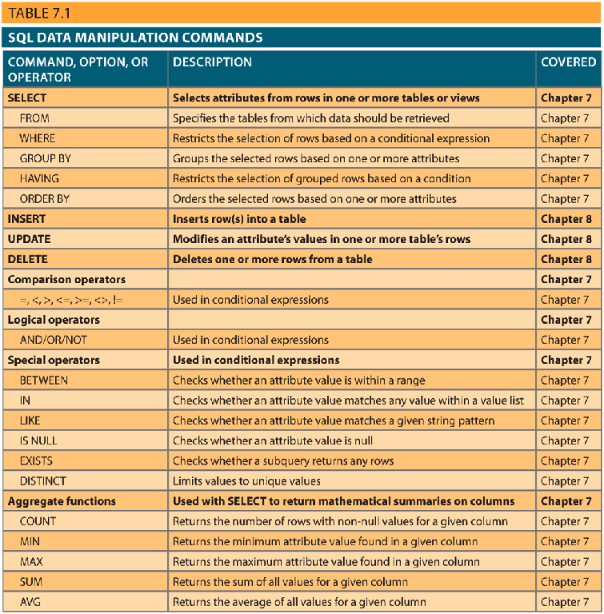
SQL Language Families
DDL: Data Definition Language
Create & alter schemas
DML: Data Manipulation Language
Manipulate date (insert/update/delete)
DCL: Data Control Language
Permissions & access
TCL: Transaction Control Language
Transactions

Slide 3
SQL DML: Insert, Update, Delete, Select

Slide 4
Entering Data
INSERT INTO tablename VALUES (value1, value2, … , valuen);
Examples:
INSERT INTO VENDOR VALUES (21225, 'Bryson, Inc.', 'Smithson', '615', '223-3234', 'TN', 'Y');
INSERT INTO VENDOR VALUES (21226, 'Superloo, Inc.', 'Flushing', '904', '215-8995', 'FL', 'N');
…
INSERT INTO PRODUCT VALUES (
'11QER/31', 'Power Painter, 15 psi., 3-nozzle', '03-Nov-17', 8, 5, 109.99, 0.00, 25595);
...

Slide 5
Rows with NULL Attributes
INSERT INTO PRODUCT VALUES
('BRT-345', 'Titanium drill bit', '18-Oct-17', 75, 10, 4.50, 0.06, NULL);
It is possible to enter NULL as an attribute value.
NULL is not the same as empty string ''

Slide 6
Rows with Optional Attributes
INSERT INTO PRODUCT( P_CODE, P_DESCRIPT) VALUES
('BRT-345', 'Titanium drill bit');
Specify mandatory attributes
You can leave out optional attributes

Slide 7
Updating Data
UPDATE tablename
SET columnname = expression [, columnname = expression ]
[ WHERE conditionlist ];

Slide 8
Deleting Data
DELETE FROM tablename
[ WHERE conditionlist ];
NOTE: If WHERE is not specified → all rows will be deleted

Slide 9
SELECT Basics

Slide 10
The whole point of storing & organizing data is to be able to produce the information we need.

Slide 11
Information Need & SQL
We usually express an information need with a question:
How many customers do we have?
How much revenue did we make last month?
Which cities do we sell to the most?
Can I get a list of all our vendors sorted by the number of products we source from them?
…
In SQL terms, we call such questions, a query. i.e to answer these questions we write & run a query.

Slide 12

How do we translate our questions
into SQL queries

Slide 13
What you will learn …
At the end of this class you will be able to:
Retrieve specific columns of data from a database table
Join multiple tables in a single SQL query
Restrict data retrievals to rows that match complex criteria

Slide 14
The Most Basic SQL Query
SELECT * FROM table;
SQL queries end with a `;`
Two SQL clauses.

Slide 15
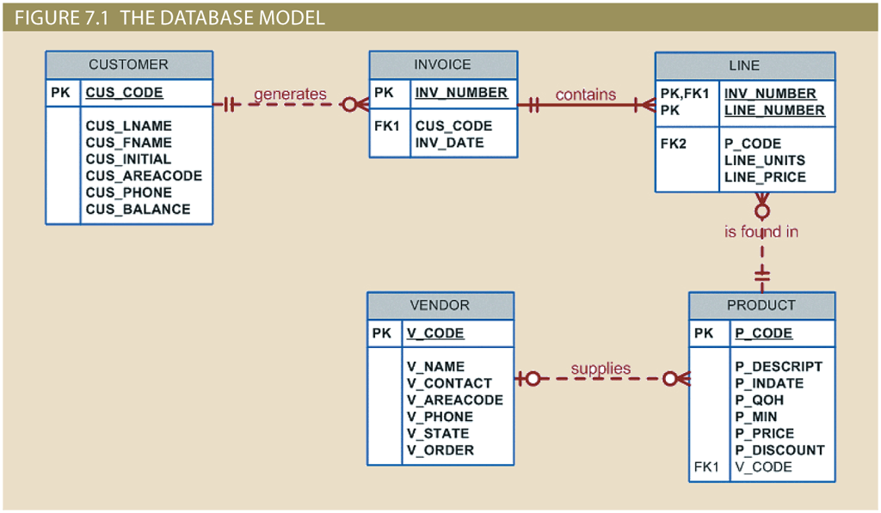
The Database Model

Slide 16
The Most Basic SQL Query
SELECT * FROM table;
Returns all data -- your entire table.

Slide 17
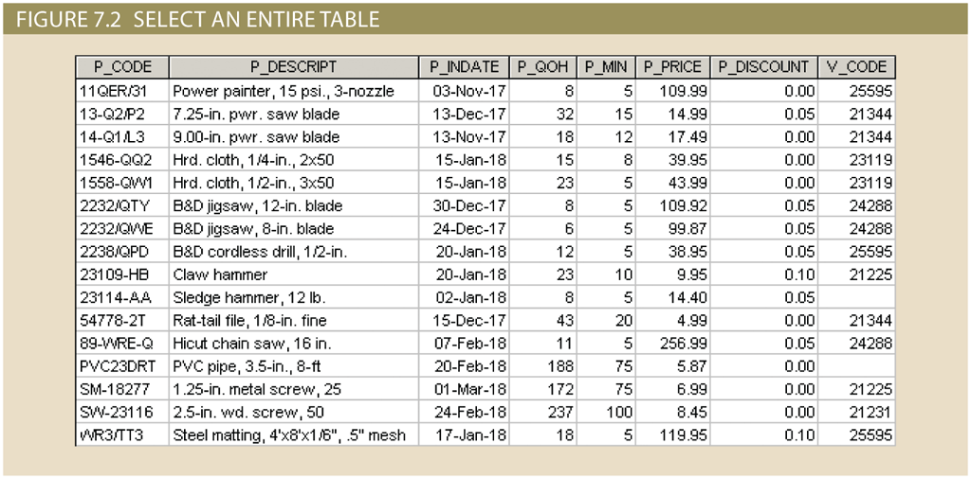
SELECT * FROM PRODUCT;

Slide 18
SELECT Clause
But sometimes you don’t want an entire table:
Maybe you just want to list products’ descriptions along with prices and the quantity remaining in your inventory. You also want to see product codes for reference.
SELECT columnlist
Specifies the attributes to be returned

Slide 19
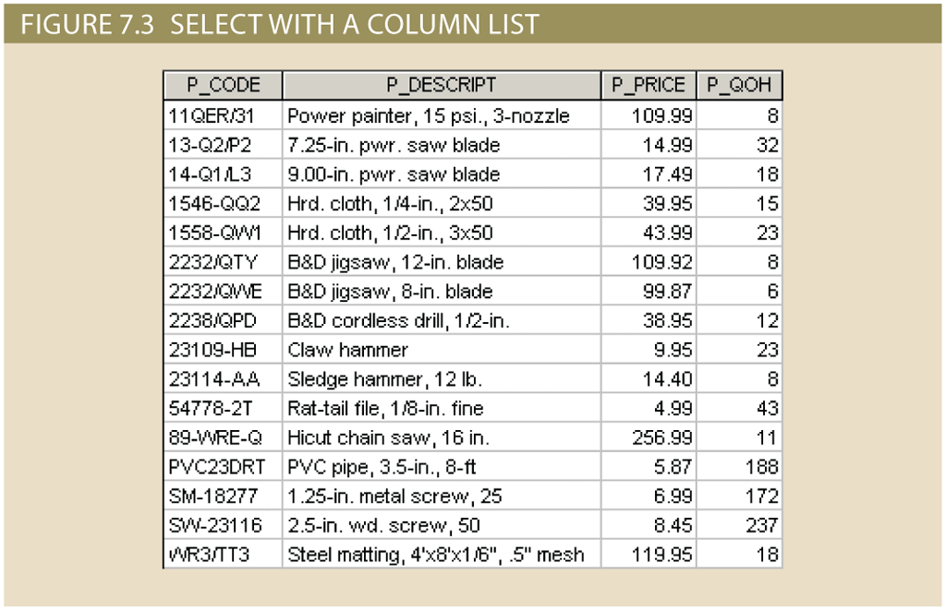
SELECT P_CODE, P_DECRIPT, P_PRICE, P_QOH
FROM PRODUCT ;
Notice that only requested columns are returned
The columns are returned in the same order as they were listed in the query.

Slide 20
ORDER BY Clause
What if you wanted to sort your products by their price?
Question: Can I get a listing of all our products and their quantities? Can you please sort the list by price?
** notice that this question is not 100% precise but good enough. You as DB designers and SQL programmers need to use your best judgments to clarify questions.**
ORDER BY columnlist [ASC|DESC]
Default

Slide 21
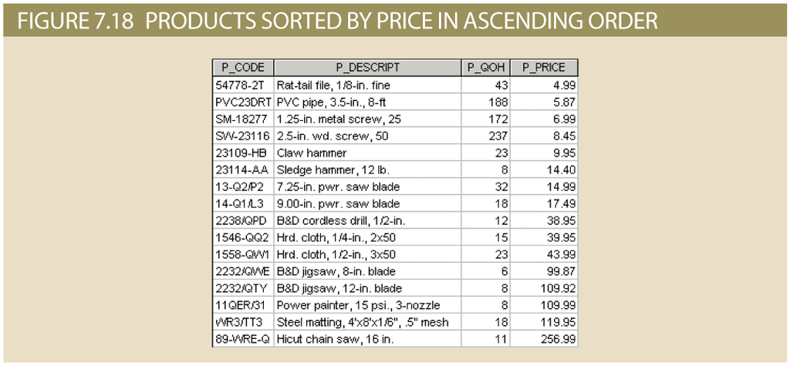
SELECT P_CODE, P_DECRIPT, P_PRICE, P_QOH
FROM PRODUCT
ORDER BY P_PRICE ;
By default sorts from lowest to highest value -- i.e. in ASCending order.
To sort so the highest price is first, choose DESC option at the end:
SELECT …
FROM PRODUCT
ORDER BY P_PRICE DESC;

Slide 22
So far ...
We have learned some very basic --and very useful-- SQL
Each query is composed of two or more clause.
We have seen the following clauses at work:
SELECT
FROM
ORDER BY
We have briefly looked at specifying columnlists in SELECT clause.
Each query ends with a ;

Slide 23
WHERE Clause
WHERE conditionlist
One or more expressions separated by logical operators
Each expression checks for the value of a specific attribute using Comparison Operators (﹦, <>, !=, <=, ...) or Special Operators (BETWEEN, IN, LIKE, IS NULL, NOT)
Usually you want to search by multiple conditions. So you use AND, OR and NOT to combine conditions.

Slide 24
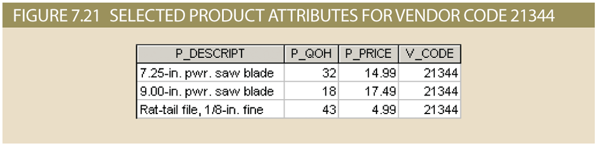
Example
SELECT P_DECRIPT, P_QOH, P_PRICE, V_CODE
FROM PRODUCT
WHERE V_CODE = 21344;
Equal To

Slide 25
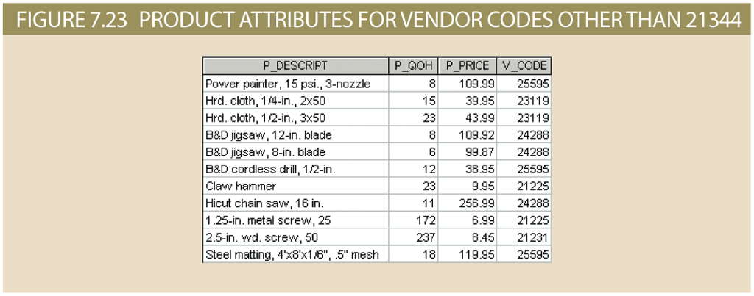
Example
SELECT P_DECRIPT, P_QOH, P_PRICE, V_CODE
FROM PRODUCT
WHERE V_CODE != 21344;
Not Equal To

Slide 26
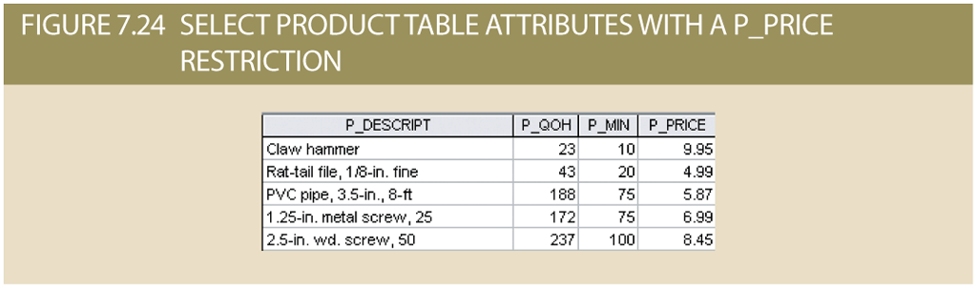
Example
SELECT P_DECRIPT, P_QOH, P_MIN, P_PRICE
FROM PRODUCT
WHERE P_PRICE <= 10;
Less than or equal To

Slide 27
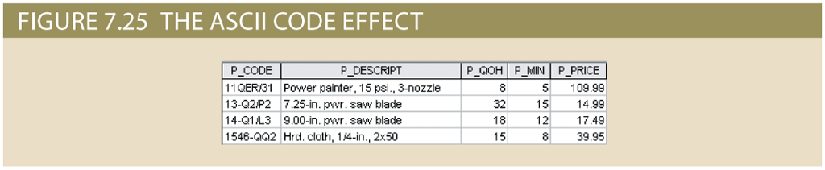
Example
SELECT P_CODE, P_DECRIPT, P_QOH, P_MIN, P_PRICE
FROM PRODUCT
WHERE P_CODE < ‘1558-QW1’;
You can also compare character attributes with Comparison Operators. (Because characters are identified with ASCII codes which are numerical)

Slide 28
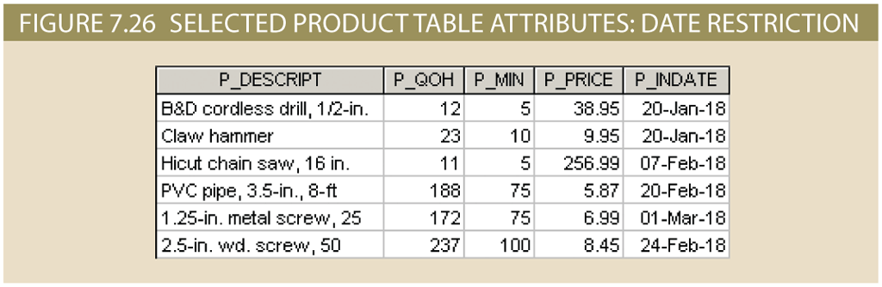
Example
SELECT P_DECRIPT, P_QOH, P_MIN, P_PRICE, P_INDATE
FROM PRODUCT
WHERE P_INDATE >= ‘20-Jan-2018’ (MS ACCESS Syntax)/
P_INDATE >= ‘2018-01-20’ (MySQL Syntax) ;
You can also compare Date attributes with Comparison Operators. (Because Dates are implemented as the number of days that have passed since a defined point of time in history )

Slide 29
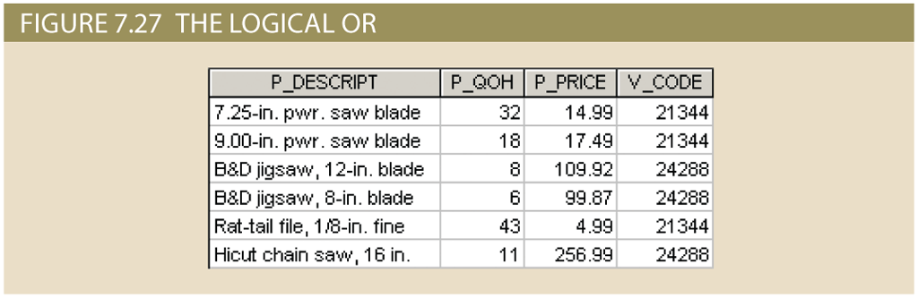
Example
SELECT P_DECRIPT, P_QOH, P_MIN, P_PRICE, V_CODE
FROM PRODUCT
WHERE V_CODE = 21344 OR V_CODE = 24288 ;

Slide 30
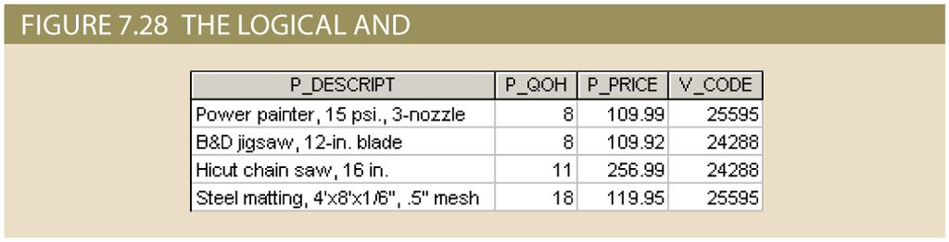
Example
SELECT P_DECRIPT, P_QOH, P_MIN, P_PRICE
FROM PRODUCT
WHERE P_PRICE > 100 AND P_QOH < 20 ;

Slide 31
FROM Clause
Sometimes the data we need is stored in multiple tables:
Question: Can I get a listing of all our products with prices and vendor info?
FROM … ?
To answer such questions, we need to bring pieces of data together from different tables.
We do this through joining tables.

Slide 32
JOIN ON Syntax
SELECT column-list
FROM table1 JOIN table2 ON join-condition;
Joining two tables results in a table.

Slide 33
Common Attribute Names
JOIN ON syntax, results in a table that includes all columns from the two tables.
You need to use table qualifiers to refer to attributes with common names in your queries:
SELECT P_DECRIPT, P_PRICE, V_NAME, V_CONTACT, V_AREACODE, V_PHONE
FROM PRODUCT JOIN VENDOR ON PRODUCT.V_CODE = VENDOR.V_CODE ;
Table Qualifiers

Slide 34
Example
Question: Can I get a listing of all our products with prices and vendor info?
To join VENDOR and PRODUCT tables, we need to find a link.
What do you think would be an appropriate link between PRODUCT and VENDOR?

Slide 35
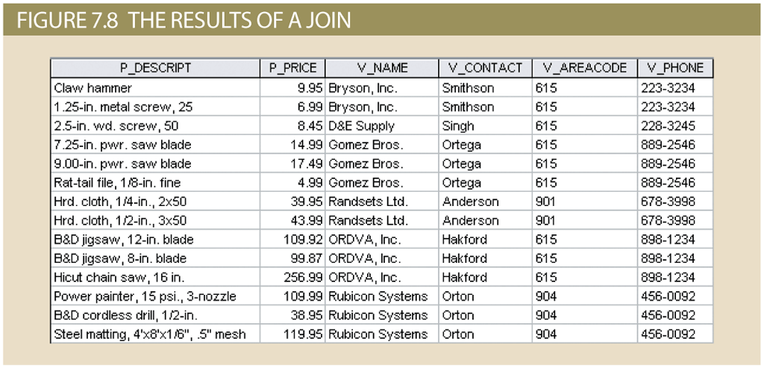
SELECT P_DECRIPT, P_PRICE, V_NAME, V_CONTACT, V_AREACODE, V_PHONE
FROM PRODUCT JOIN VENDOR ON PRODUCT.V_CODE = VENDOR.V_CODE ;

Slide 36
Outer Joins
JOIN ON performs what is known as an inner join
→ Only returns matched records
But there are also outer joins
→ (Matched records + unmatched records from one or both of the tables) are returned
→ 3 types: LEFT OUTER JOIN, RIGHT OUTER JOIN, FULL OUTER JOIN

Slide 37
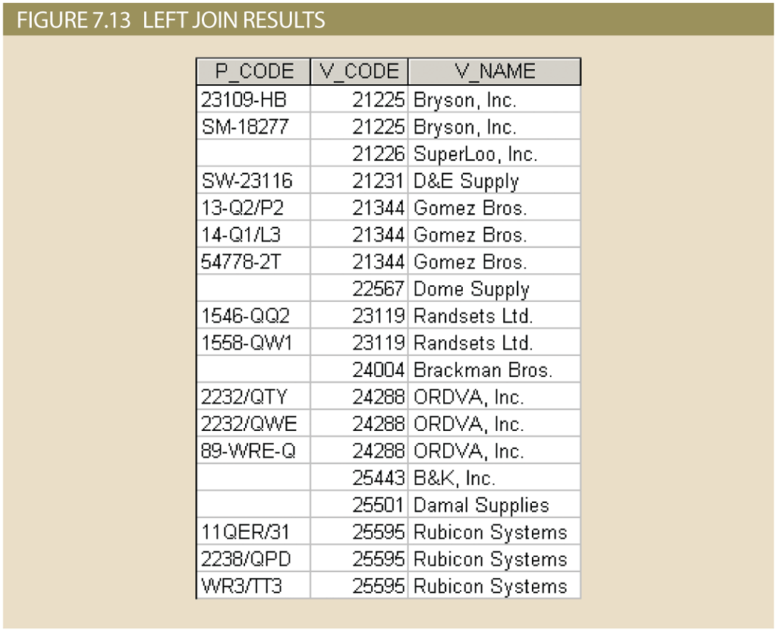
LEFT JOIN
SELECT P_CODE, VENDOR.V_CODE, V_NAME
FROM VENDOR LEFT JOIN PRODUCT ON VENDOR.V_CODE = PRODUCT.V_CODE;
Returns all vendors and the products they supply.
Vendors who supply more than one product are listed more than once.
Vendors that don’t supply any products are also listed → with a NULL product record
i.e all records from the left table (VENDOR) are returned even if unmatched.

Slide 38
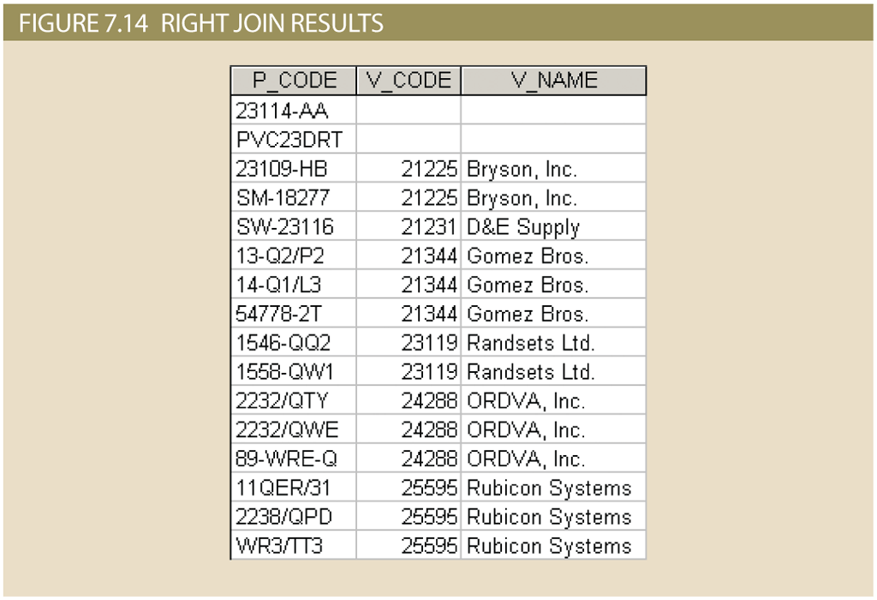
RIGHT JOIN
SELECT P_CODE, VENDOR.V_CODE, V_NAME
FROM VENDOR RIGHT JOIN PRODUCT ON VENDOR.V_CODE = PRODUCT.V_CODE;
Returns all products and the vendors.
All products are listed once.
Products that are not supplied by a vendor are listed as well. (with NULL vendor info)
i.e all records from the right table (PRODUCT) are returned even if unmatched.

Slide 39
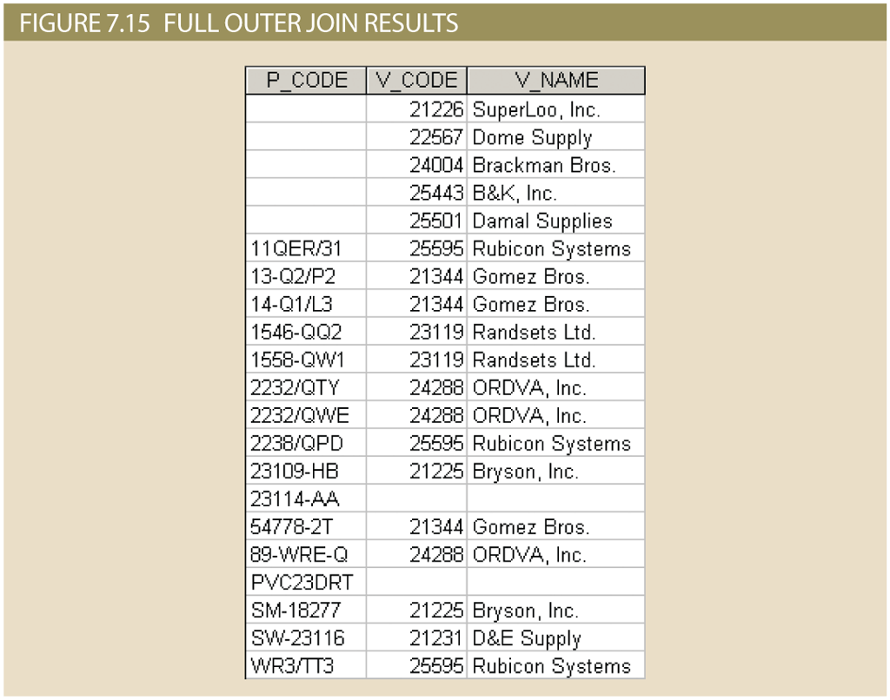
FULL JOIN
SELECT P_CODE, VENDOR.V_CODE, V_NAME
FROM VENDOR FULL JOIN PRODUCT ON VENDOR.V_CODE = PRODUCT.V_CODE;
Returns all products & all vendors either matched or unmatched

Slide 40
WHERE Clause
Suppose you want to know all VENDORs who are not currently supplying any products.
→ One way to answer this question is to use a JOIN to return all VENDORs matched with their products. If the product info for a vendor is null, we know they don’t supply any products
SELECT P_CODE, VENDOR.V_CODE, V_NAME
FROM VENDOR LEFT JOIN PRODUCT ON VENDOR.V_CODE = PRODUCT.V_CODE
WHERE P_CODE IS NULL;

Slide 41
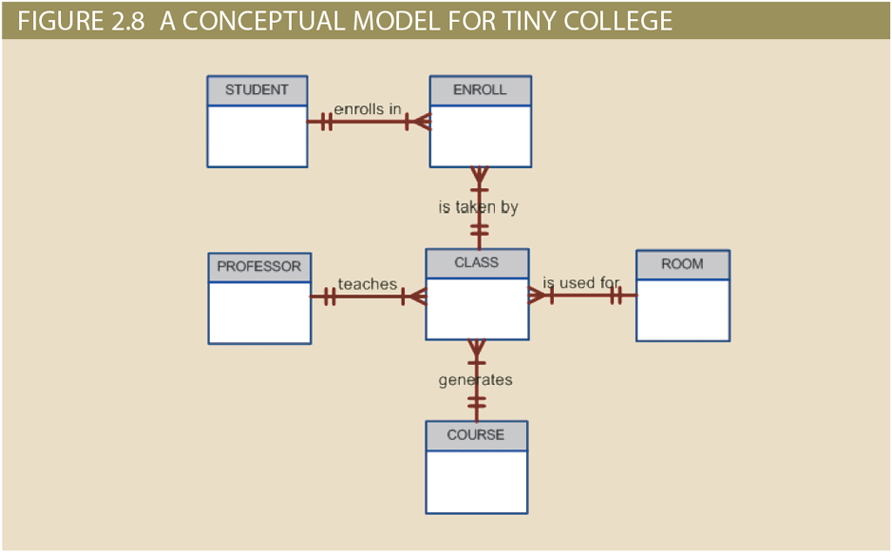
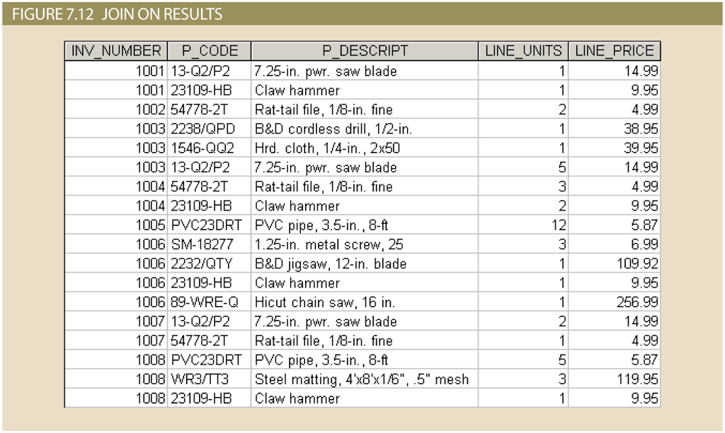
Some Notes About JOINs
Joins are the real power behind the relational database
allow information to be combined intelligently from two or more tables
DATABASE DESIGN
DATA RETRIEVAL
DECOMPOSE
Designer decomposes an integrated set of data into separate entities.
JOIN
Programmer re-integrates pieces of the data.

Slide 42
A Few Notes
Different DMBSs expect different Date formats
Character & Date values must be quoted with apostrophes
As with creating tables, the order of operations matters
Most RDBMSs allow you to import data from CSV files

Slide 43
Summary
SELECT -- specifies attributes to be returned
FROM -- specifies the table(s) from which data will be retrieved
WHERE -- filters the rows of data based on provided condition
ORDER By -- sorts the final results (ASC, DESC)
JOIN -- combines data from two or more tables

